Slide 1

Deductive Machine Learning
Cristina David
cristina.david@cs.ox.ac.uk
Lucas Cordeiro
lucas.cordeiro@cs.ox.ac.uk

Slide 2
Deductive machine learning
Its goal is to provide computers with the ability to automatically learn a behavior that provably satisfies a given high-level specification
As opposed to inductive techniques, which generalise from incomplete specifications, deductive machine learning starts with a complete problem description and develops a behaviour as a particular solution
specification
model-level
induction
deduction
training data
transductive
predicted behaviour
data-level

Slide 3
Practical applications
Game playing strategy: given the specification of the winning criteria for a two-player game, learn a winning strategy
Program repair: given a buggy program according to a correctness specification, learn a repair that makes the program correct
Lock-free data structures: learn a data structure that guarantees the progress of at least one thread when executing multi-threaded procedures, thereby helping to avoid deadlock

Slide 4
Practical applications
Security exploit generation: learn code that takes advantage of a security vulnerability present in a given software to cause unintended behavior of that software
Security/cryptographic protocol: learn a protocol that performs a security-related function and potentially applies cryptographic methods
Compression: learn an encoding for some given data that uses fewer bits than the original representation
Control System: learn reliable implementations of digital controllers

Slide 5
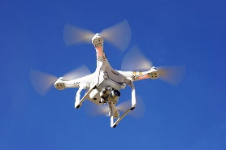
Control software in unmanned aerial vehicle
A*, LPA* and D*Lite to solve the shortest path problem
What is the shortest trajectory?
Obstacle
4
Obstacle 1
Obstacle
3
Obstacle 2
Goal
Flight Planning
System’s dynamics
UAV
Position References
Attitude Digital Controller
(Pitch,Roll, Yaw)
Attitude System
Altitude and Position System
Attitude and Position Controllers
u(t)
A/D
r(t)
Angles References
Notes:
5

Slide 6
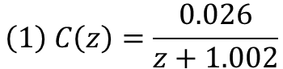
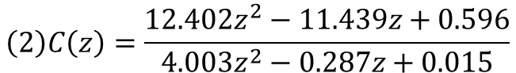
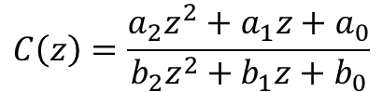
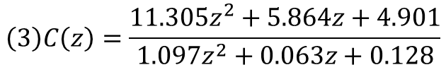
Synthesizing control software in UAVs
Counterexample guided induction synthesis automates the controller design that is correct-by-construction
stability, safety, performance specifications
Input specification
initial example
of a candidate
solution
candidate
solution
Synthesize
Verify
INPUTS
finite-precision arithmetic and related rounding errors
counter-
example
synthesis failed
verification successful
Notes:
6

Slide 7
Startup is using drones to deliver medicine

